Slide 1
Connect Four
Project 1
Ernest

Slide 2
Features
2-player mode (Alternate between red and yellow ‘chips’)
Game ends in either win or draw.
Win is achieved when either player has positioned 4 ‘chips’ in a vertical / horizontal / diagonal upwards / diagonal downwards stack.
Draw is achieved when there are no more white cells left on the board.
Message to indicate current player
Alert to indicate game outcome
Reset button

Slide 3
To-do List
Create game grid - table with 7 columns, 6 rows
Add event listener to each cell, on click - to change cell colour of bottom-most row with a white cell from white to player’s colour (red / yellow)
Alternate player’s turn and ‘chip’ colour (i.e. red > yellow > red …) + display who is the current player
Set outcome for win and draw + display winner
Reset game when either outcome has been achieved

Slide 4
Key Challenges

Slide 5
Key Challenges
Making the ‘chips' stack on top of each other
New ‘chip’ ignores occupied cell and fills white cell above it
Identify which is the bottom-most cell that is white
Setting conditions for win and draw
Win: When either player has positioned 4 ‘chips’ in a vertical / horizontal / diagonal stack
Draw: When there are no more white cells left on the grid

Slide 6
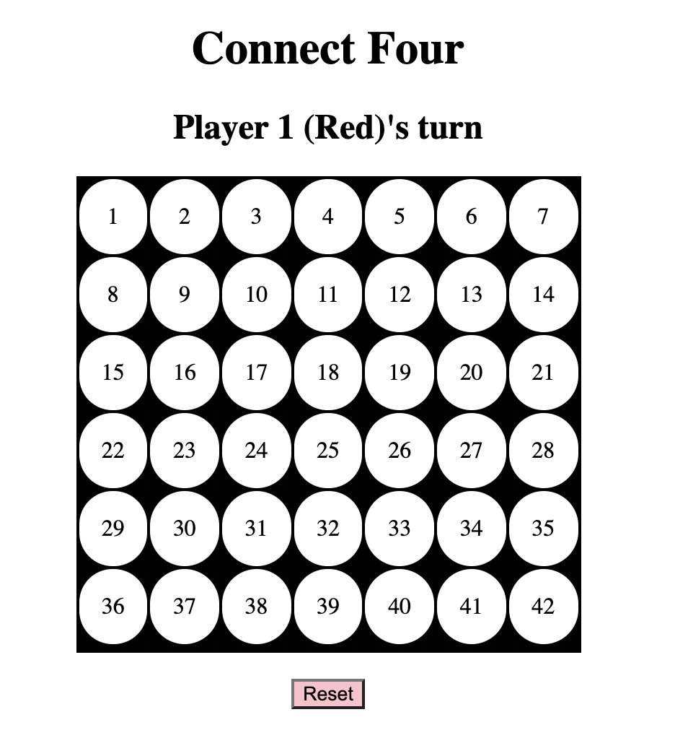
Understanding the grid’s boundaries
cellIndex
[rowIndex, cellIndex]
[0,0] … [0,6]
…………….
[5,0] … [5,6]
[0]
[6]
[0]
rowIndex
[5]

Slide 7
Key Challenge 1: Stacking ‘chips’
Overview
Check the cell's colour starting from row[5] to row[0] (as cells are filled from bottom up) to see if it's white
If cell in current row is white, push selected cell to array
If current player = Player 1 (red), retrieve cell from array, change cell to red
If current player = Player 2 (yellow), retrieve cell from array, change cell to yellow
If there are 4 red/yellow cells in a row, announce Player 1/2 as winner, restart game

Slide 8
Key Challenge 1: Stacking ‘chips’
Understanding Row Index and Cell Index
 | row Index | cell Index | cell value
<tr> | 0
<td> | 0 | 0 | 1
<td> | 0 | 1 | 2
<td> | 0 | 2 | 3
<td> | 0 | 3 | 4
<td> | 0 | 4 | 5
<td> | 0 | 5 | 6
<td> | 0 | 6 | 7
<tr> | 1
<td> | 1 | 0 | 8
<td> | 1 | 1 | 9
<td> | 1 | 2 | 10
<td> | 1 | 3 | 11
<td> | 1 | 4 | 12
<td> | 1 | 5 | 13
<td> | 1 | 6 | 14

Slide 9
Key Challenge 2a: Setting win conditions
Four possible scenarios
cellIndex
Horizontal ( — )
Vertical ( | )
Diagonal ( / )
Diagonal ( \ )
[0]
[6]
[0]
rowIndex
[5]

Slide 10
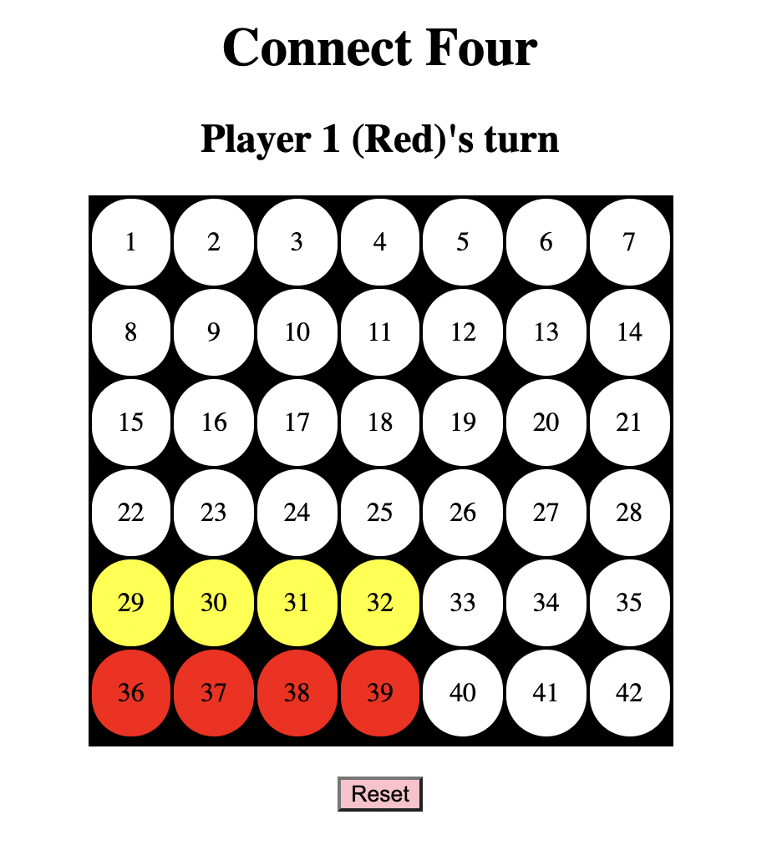
Key Challenge 2a: Setting win conditions
Scenario 1: Horizontal ( — )
cellIndex
[rowIndex, cellIndex]
[5,0], [5,1], [5,2], [5,3]
[r, c], [r, c+1], [r, c+2], [r, c+3]
Based on above pattern, possible starting values:
r: 0 - 5
c: 0 - 3
[0]
[6]
[0]
rowIndex
[5]
[5,0], [5,1], [5,2], [5,3]

Slide 11
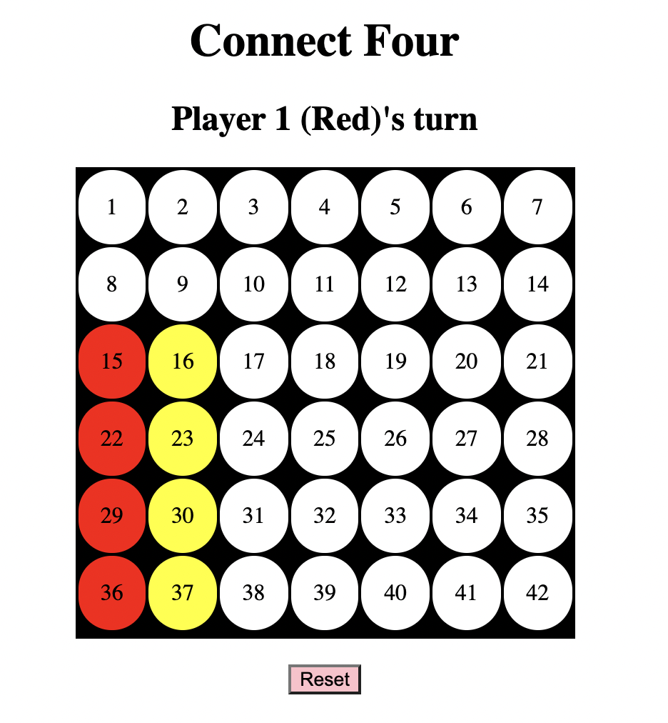
Key Challenge 2a: Setting win conditions
Scenario 2: Vertical ( | )
cellIndex
[rowIndex, cellIndex]
[5,0], [4,0], [3,0], [2,0]
[r, c], [r - 1, c], [r - 2, c], [r - 3, c]
Based on above pattern, possible starting values:
r: 3 - 5
c: 0 - 6
[0]
[6]
[0]
[2,0]
[3,0]
[4,0]
[5,0]
rowIndex
[5]

Slide 12
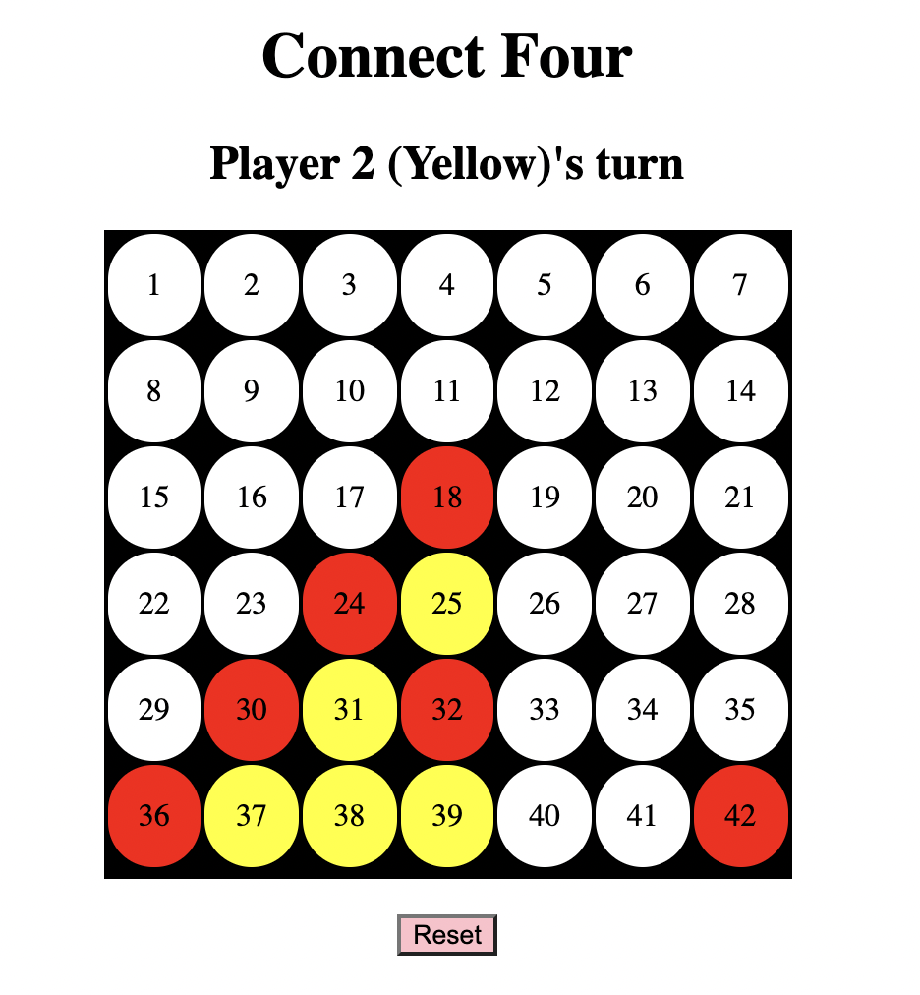
Key Challenge 2a: Setting win conditions
Scenario 3: Diagonal (Up-Right) ( / )
cellIndex
[rowIndex, cellIndex]
[5,0], [4,1], [3,2], [2,3]
[r, c], [r - 1, c + 1], [r - 2, c + 2], [r - 3, c + 3]
Based on above pattern, possible starting values:
r: 3 - 5
c: 0 - 3
[0]
[6]
[0]
rowIndex
[5]

Slide 13
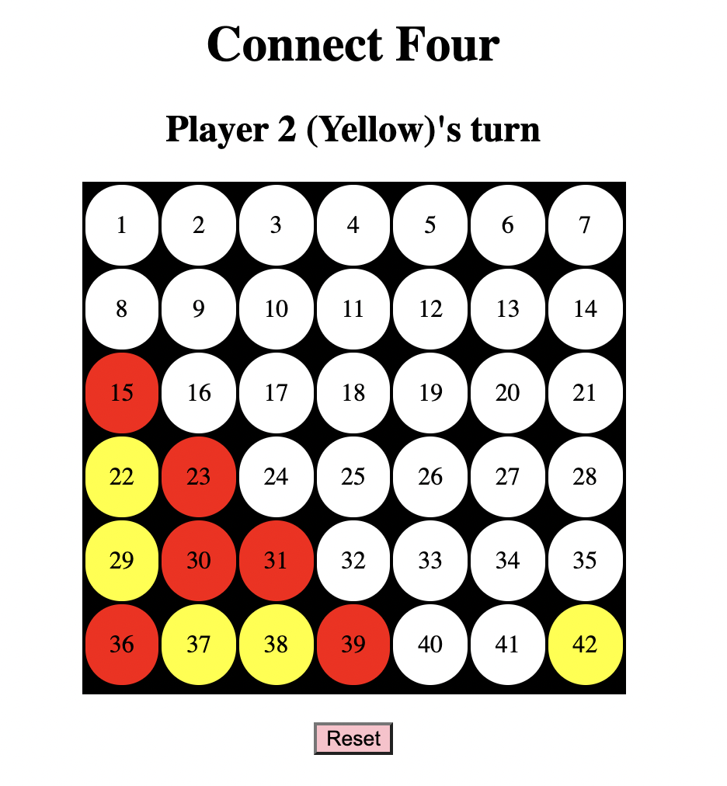
Key Challenge 2a: Setting win conditions
Scenario 4: Diagonal (Down-Right) ( \ )
cellIndex
[rowIndex, cellIndex]
[2,0], [3,1], [4,2], [5,3]
[r, c], [r + 1 , c + 1], [r + 2, c + 2], [r + 3, c + 3]
Based on above pattern, possible starting values:
r: 0 - 2
c: 0 - 3
[0]
[6]
[0]
rowIndex
[5]

Slide 14
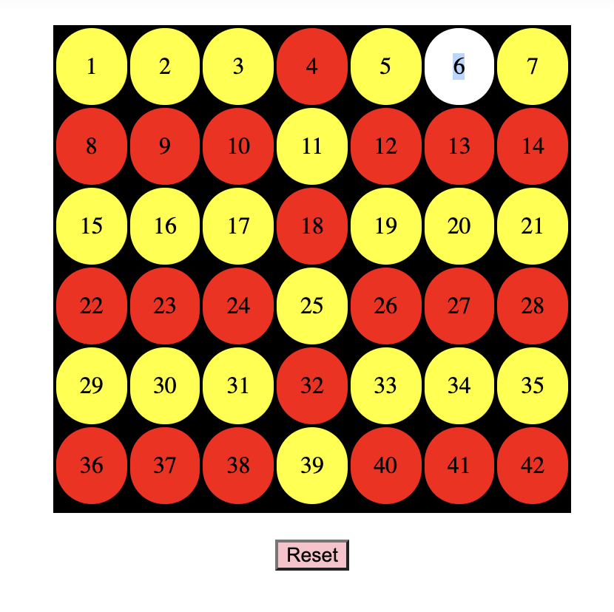
Key Challenge 2b: Setting draw condition
Draw: When there are no more white cells left on the grid
If cell is coloured -> push into ‘Coloured’ array
If length of ‘Coloured’ array (number of coloured cells) is equal to the total number of cells (gridCell.length), game is declared a draw

Slide 15
Concepts applied
addEventListener (DOM events) - each circle to trigger colour change, reset button
Arrays
Store selected cell that is white, before retrieving it and changing its colour to player’s colour (red / yellow)
Store coloured cells and check against grid cells (if equal number -> game is a draw)
forEach - can be used on NodeLists as well (not just for Arrays)
Formatting table cells - Using (td class="circle" style="background-color: white”) to set colour, (td bgcolor =“white”) has been deprecated
cellIndex - return the column index of a <td> element
rowIndex - return the index of a <tr> element

Slide 16
References
How To Build A Game Of Connect Four With Vanilla JavaScript (https://www.youtube.com/watch?v=Z_IaJQojun8)
Connect Four Game Checking for Wins JS (https://stackoverflow.com/questions/33181356/connect-four-game-checking-for-wins-js)
How to addEventListener to table cells (https://stackoverflow.com/questions/46341171/how-to-addeventlistener-to-table-cells)
How to return the row and column index of a table cell by clicking (https://stackoverflow.com/questions/45656949/how-to-return-the-row-and-column-index-of-a-table-cell-by-clicking)

Slide 17
Thank you!

